Slide 1
PROMETEO concept
Igor Farnè
BL Car IDA

Slide 2


PROMETEO - concept
The PROfessional MEasurement Tester for Electrical Overstress is a portable curve tracer for ICs.
Each pin is measured separately independent of design/application
  Product specific library is used to classify known products pass or fail with regard to electrical overstress
It works with a laptop with USB connection
A graphic user interface is used for high level and easy use
It is suitable for different packages , with the use of adapter containing the package socket
DUT
uC
USB

Slide 3
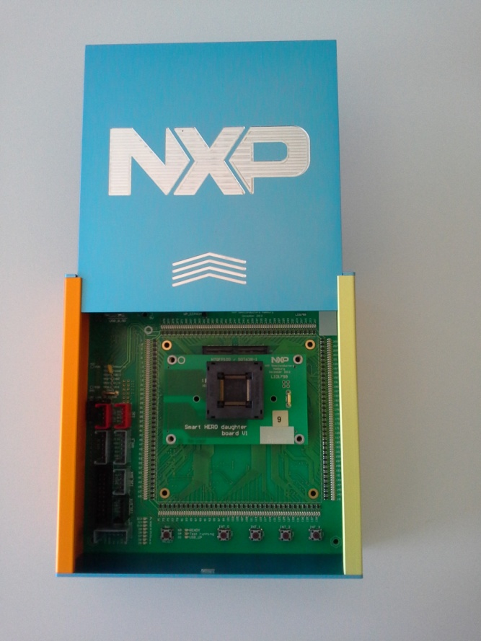

PROMETEO – how it looks
PROMETEO box (close)
Adapter
PROMETEO box (open)

Slide 4
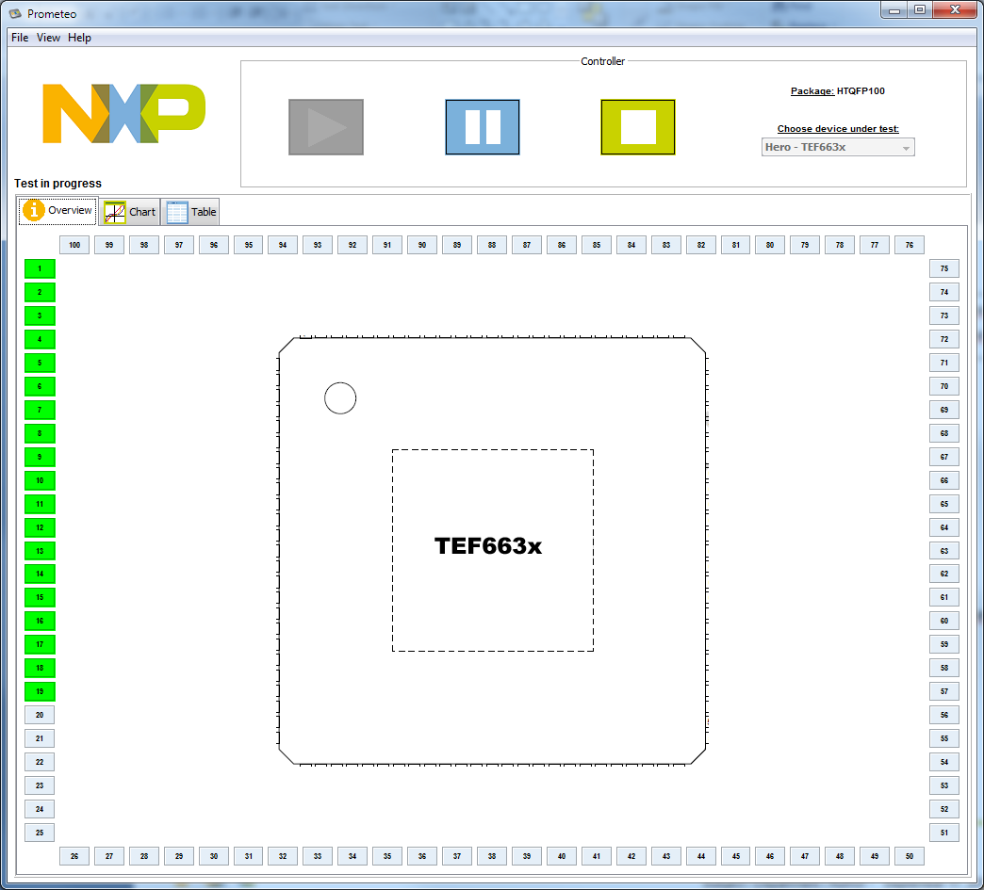
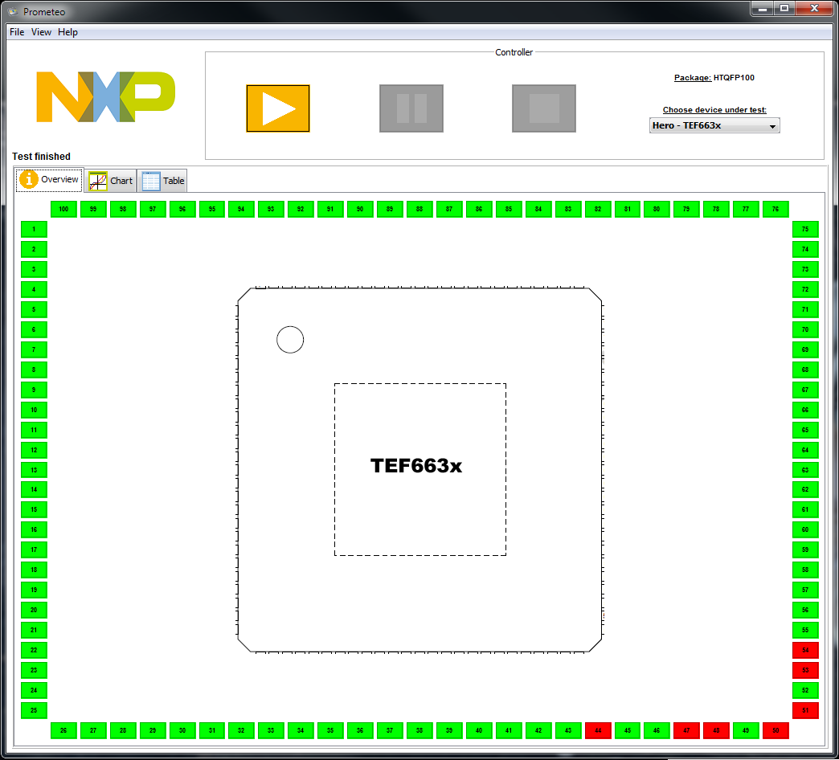

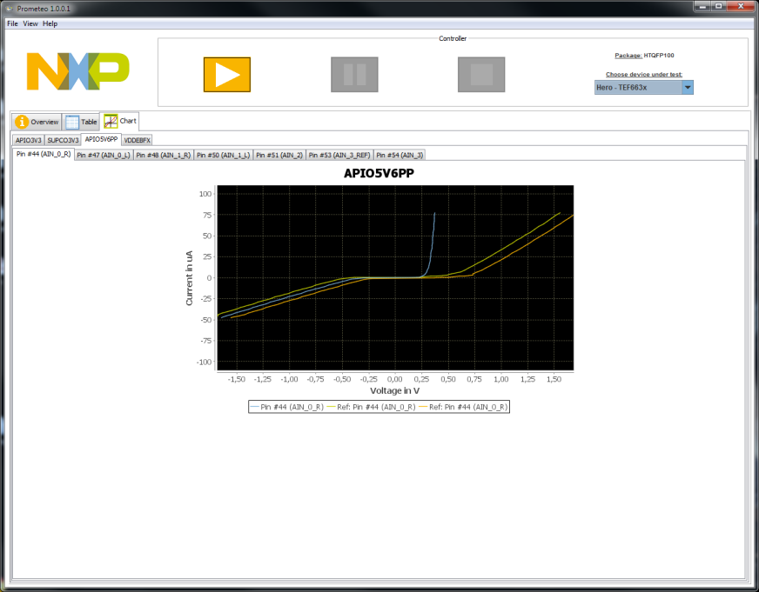
Graphic User Interface (GUI) as shown on laptop - library
Test in progress
Test finished
good
fail
I/V curve on failing pin
With the use of command buttons the test can be started, paused and stopped.
Classification of fails according to the product library reference curve is facilitated with color coding on each pin.
I/V Curve of each pin can be shown in the chart tab

Slide 5
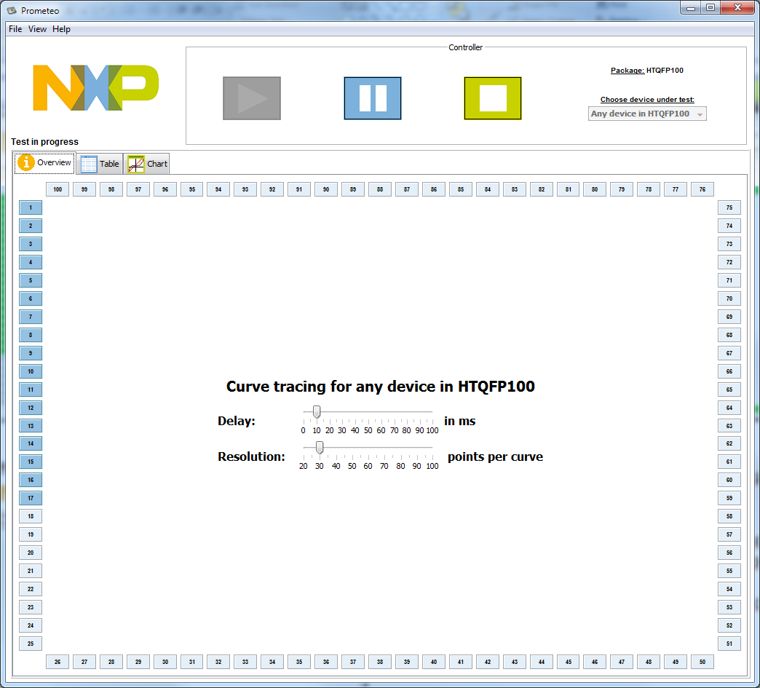
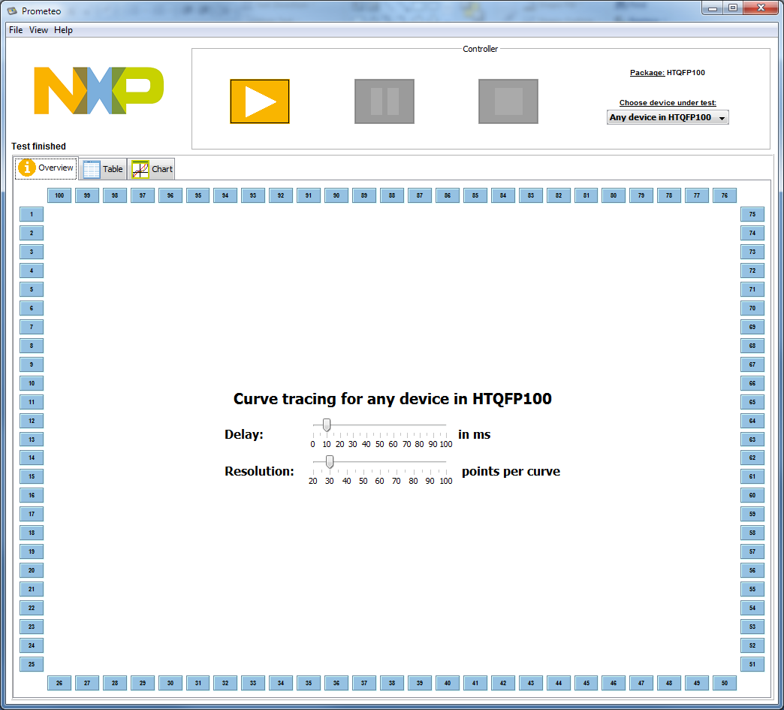
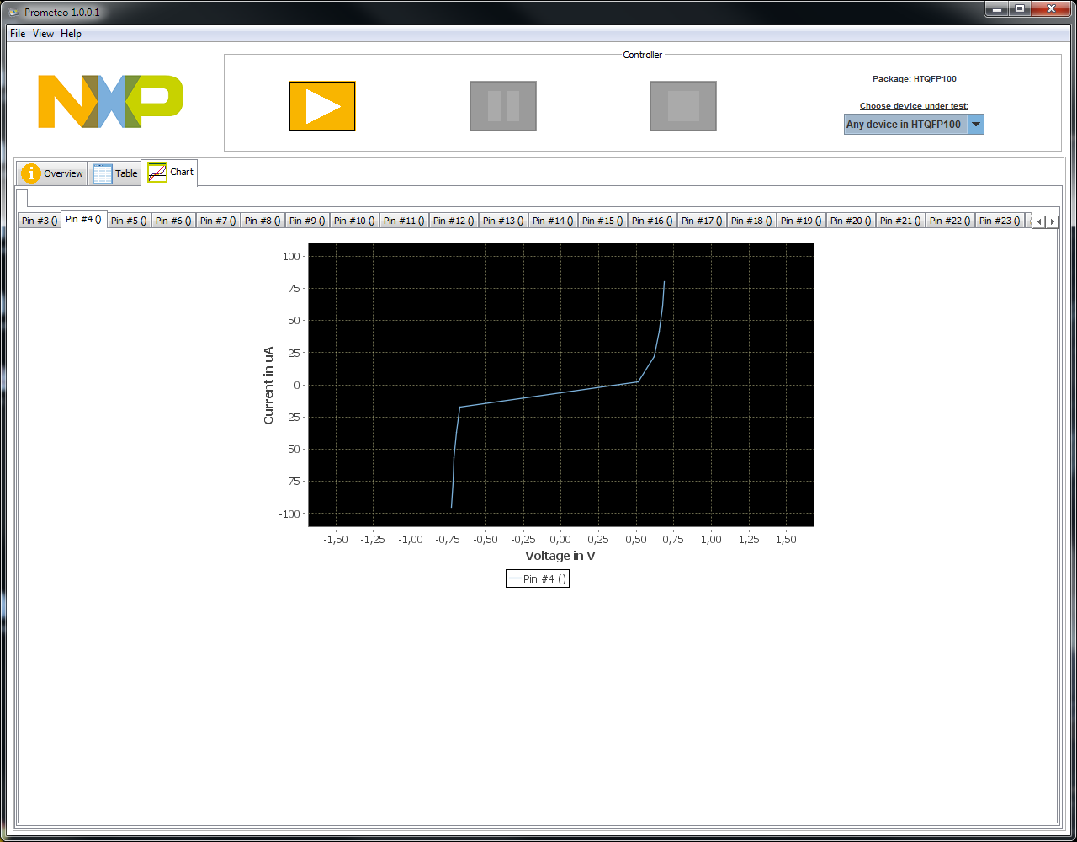
Graphic User Interface (GUI) as shown on laptop – without library
Test in progress
Test completed
I/V curve on tested pin
Here the testing is performed without using the library
I/V Curve measured on each pin can be shown in the chart tab

